Slide 1
2015 Performance Appraisal (PA) Communications Update
December 5, 2014

Slide 2
Content
Updated 2015 PA Cycle Communications Plan
Next Steps
Reference
  Communications Strategy
  What’s Different this Year
  2015 PA Timeline

Slide 3
PA Cycle Communications - Appraise & Allocate
In Progress
Done
Dropped
Date | Activity | Target Audience (Sequence) | Method | Desired Outcomes | Owner
3-Nov-14 | Executive briefing | Executive Staff HR Staff | Presentation | Information sharing, approval | Tobin/Jerry
On or about 10-Nov | Kick-off communication | Executive Staff HR Staff All Managers | Email | Mutual understanding of timeline and expectations | Tobin/Jerry
Weeks of 3-Nov, 10-Nov | HR train-the-trainer sessions | HR Managers, HR PA Points of Contact | Webinars | Equipping local HR to train, support managers | Jerry
Week of 10-Nov | Send out kick-off webinar invitations | HR Staff All Managers | Outlook | Webinar invitations sent via Outlook | Jerry
Week of 17-Nov | Kick-off webinars | HR Staff (FYI) All Managers | Global webinars (2) | Inform, expectation setting, point to tools | Jerry
Week of 17-Nov | Kick-off communication to employees | All Employees | The Connection, Circuit, email | Inform, expectation setting, point to tools | Jerry, Kris
Wks of 24-Nov, 1-Dec | Training on writing PA, using Oracle PM | New manager or need refresh | Job aid, online, local sessions | Inform, help on applying tools | Jerry, HR Managers
Wks of 24-Nov, 1-Dec | PA Dashboard training, as needed | Mgr 1-2-3, new or needing refresh | Job aid, online, local sessions | Understand how to use PA Dashboard | Jerry, HR Managers
Week of 15-Dec | Updates and reminders for entering ratings in Oracle PM | HR Staff All Managers | Email | Preliminary ratings entered into Oracle PM | Jerry, Kris
Week of 15-Dec | Reminder of schedule Webinar invitations for Comp & Benefit webinars | HR Staff Execs All Managers | Email | Reminder of PA schedule Comp and Benefits webinar Invitations sent | Jerry, Kris Jason, Roberta
About 18-Dec, 2-Jan, 6-Jan, 7-Jan | Targeted reminder to appraisers & approvers | Appraisers and approvers who still have actions to take | Oracle EBS email | Reminder of need to submit or disposition PAs | Jerry
a
a
a
a
a
a
Done wk of 1-Dec
Delayed to wk of 8-Dec

Slide 4
PA Cycle Communications – Allocate & Delivery
In Progress
Done
Dropped
Date | Activity | Target Audience (Sequence) | Method | Desired Outcomes | Owner
Week of 5-Jan. | Comp & Benefits webinars | HR Staff All Managers | Global webinars (2) | Understand and able to apply compensation philosophy | Jason, Roberts
Weeks of 5-Jan, 12-Jan | Training on using Comp Workbench (CWB) | Local Managers | Online, local sessions as needed | Understand and be able to apply | Jason, HR Managers
On or about 22-Jan | Reminder of approaching Jan. 27 deadline | All Managers | Email | Reminder that Oracle CWB closes Jan. 27 | Jason, Kris
On or about 27-Jan | Notification of closure | All Managers | Email | Notification that Oracle CWB is closed | Jason, Kris
Week of 19-Feb | Schedule reminder, invitations to delivery webinars | Executives HR Staff All Managers | Email, possibly The Connection, Circuit | Begin preparing for PA delivery, Outlook invitations sent | Jerry, Kris
Week of 23-Feb | Refresh on Appraisal Delivery | All Managers | Global webinars (2), local sessions as needed | Understand and be able to apply | Jerry, Jason, local HR
2-Mar | Reminder 1:1 delivery schedule is only 3 weeks | Local Managers | Email | Understand and be able to apply | Jerry, HR Managers
2-Mar | Email notification | All Employees | The Connection, Circuit, email | What they should expect of their managers during delivery | Jerry, Kris
Week of 16-Mar | Reminder of approaching March 20 deadline | All Managers | Email | Complete 1:1 deliveries | Jerry
On or about 23-Mar | Notification to employees of Oracle feedback period | All Employees | The Connection, Circuit, email | Employees go online and begin providing feedback | Jerry, Kris
On or about 27-Mar | Reminder to provide feedback in Oracle | Employees with Oracle access | Oracle EBS email | Employees go into Oracle and provide feedback by 30-Mar | Jerry, HRIS

Slide 5
Next Steps
Week of 8-Dec - schedule PA Dashboard training webinars
Week of 15-Dec - schedule reminder email to managers
Continue providing regular updates to HR community during the PA process (in progress)
Questions or comments?
  For PA contact Jerry Crawford
  For Merit & Equity contact Jason Overstreet
Notes:
What do they expect of me as corporate program owner?
What can I expect of them?

Slide 6
reference

Slide 7
Communication Strategy & Owners
Provide necessary info for manager and employees, when needed
Communication sequence facilitates “no surprises”
  SVP HR & HR staff
  Executives
  HR Managers and Business Partners
  Managers
  Employees
Corporate HR communications cover the “common basics”
  Regional HR communication fills in the rest
Ownership of PA and Compensation communications
  PA = Jerry, Joni
  Compensation & Benefits = Jason, Roberta
  Communications = Kris Martino, Brittany Sener

Slide 8
What’s Different This Year
Acting on your feedback, we are shrinking cycle by 24% (6 weeks)
  Start 2 weeks later, end 4 weeks earlier
Former Truesense and former Aptina employees will participate
Oracle upgraded to 12.2.3 but functionality very similar
System reminders sent “as needed” prior to key end dates during cycle
  Appraiser - to submit
  Approver - to approve
  Appraisee - to provide feedback
Points to be selectively emphasized in communications and training
  IGDPs¹ for Grade 16 and above need to be completed by end 30-Jan-15 (new)
  Message to SOX² controls owners (n=~145) and their managers - need to include performance to expectation on SOX control(s) (new)
  Nine box 7 is intended for IDLs “new to role” but not required
  Help appraisees remember their PA template type
1 – Individual Goal and Development Plan 2 – Sarbanes Oxley Act of 2002
Notes:
Aptina – we didn’t have SOX compliance…. Might be new for someone… Jerry – check for Aptina owners
Q – they know? Yes
Q – HR know who they are? No, but I will check if I can notify you

Slide 9
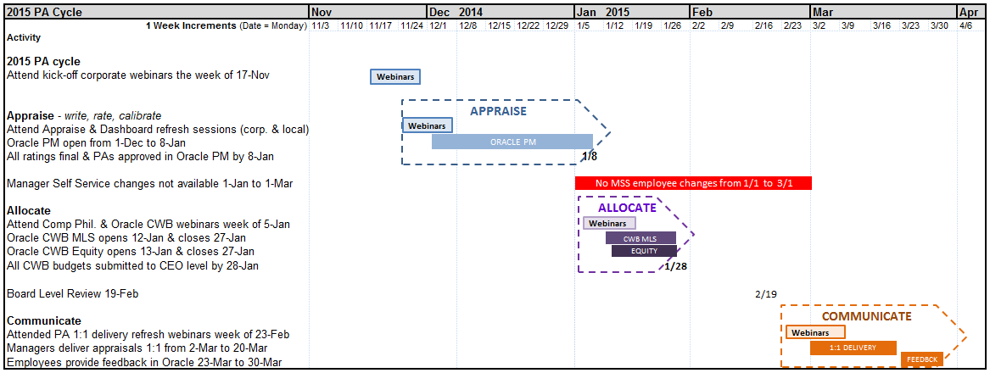
2015 PA Timeline
“Appraise” starts 2 weeks later, still have 6 weeks
“Communicate” shortened 4 weeks on the backend
  Appraiser delivery of PA 1:1 reduced to 3 weeks (from four)
  Appraisee feedback in Oracle reduced to 1 week (from four)

